Slide 1
Kiko Technology
Stakehill Greenhouse Tomato
Shelf Life Trial
40 Days No Refrigeration
Perino Grape Tomato
13th May 2013 to
23rd June 2014

Slide 2
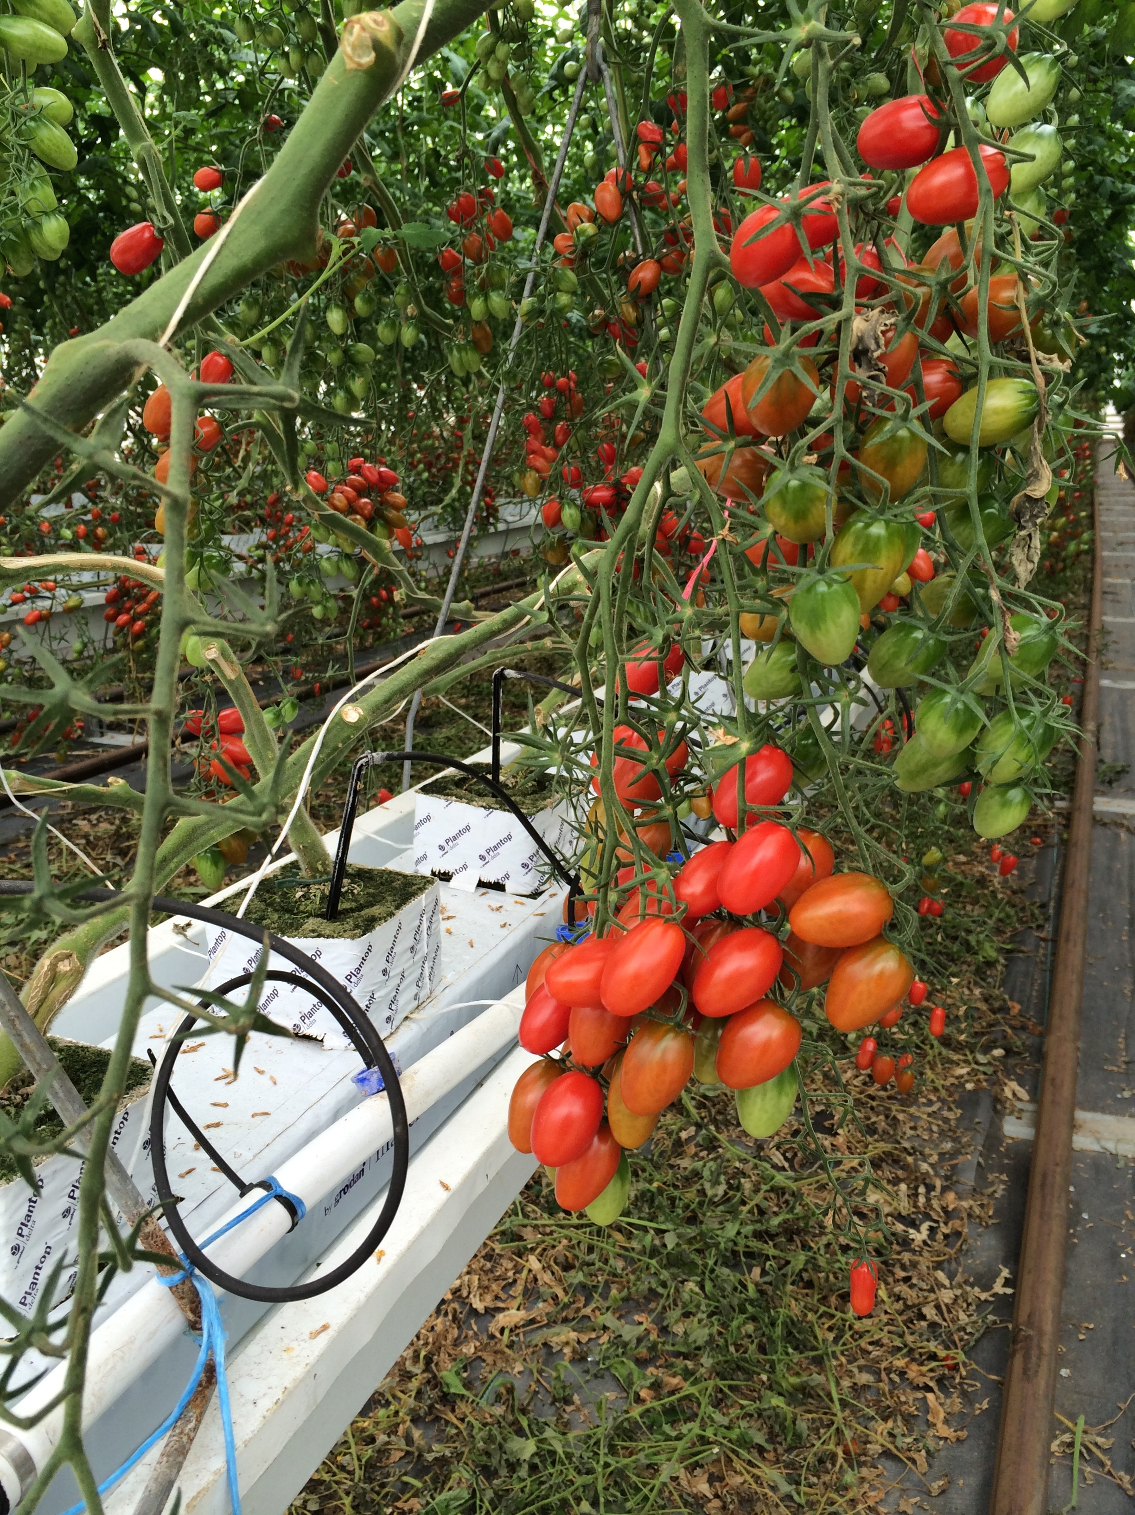
13th May 2014

Slide 3
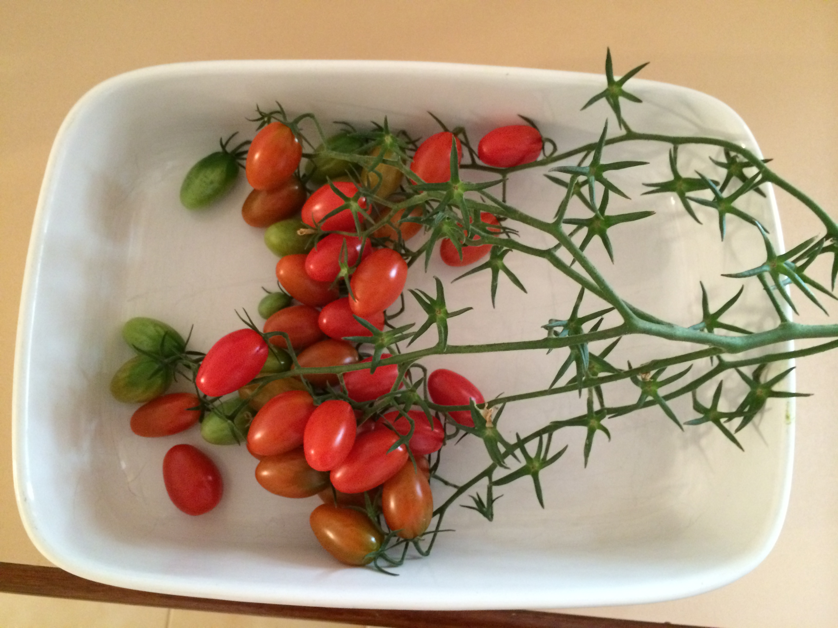
13th May 2014

Slide 4
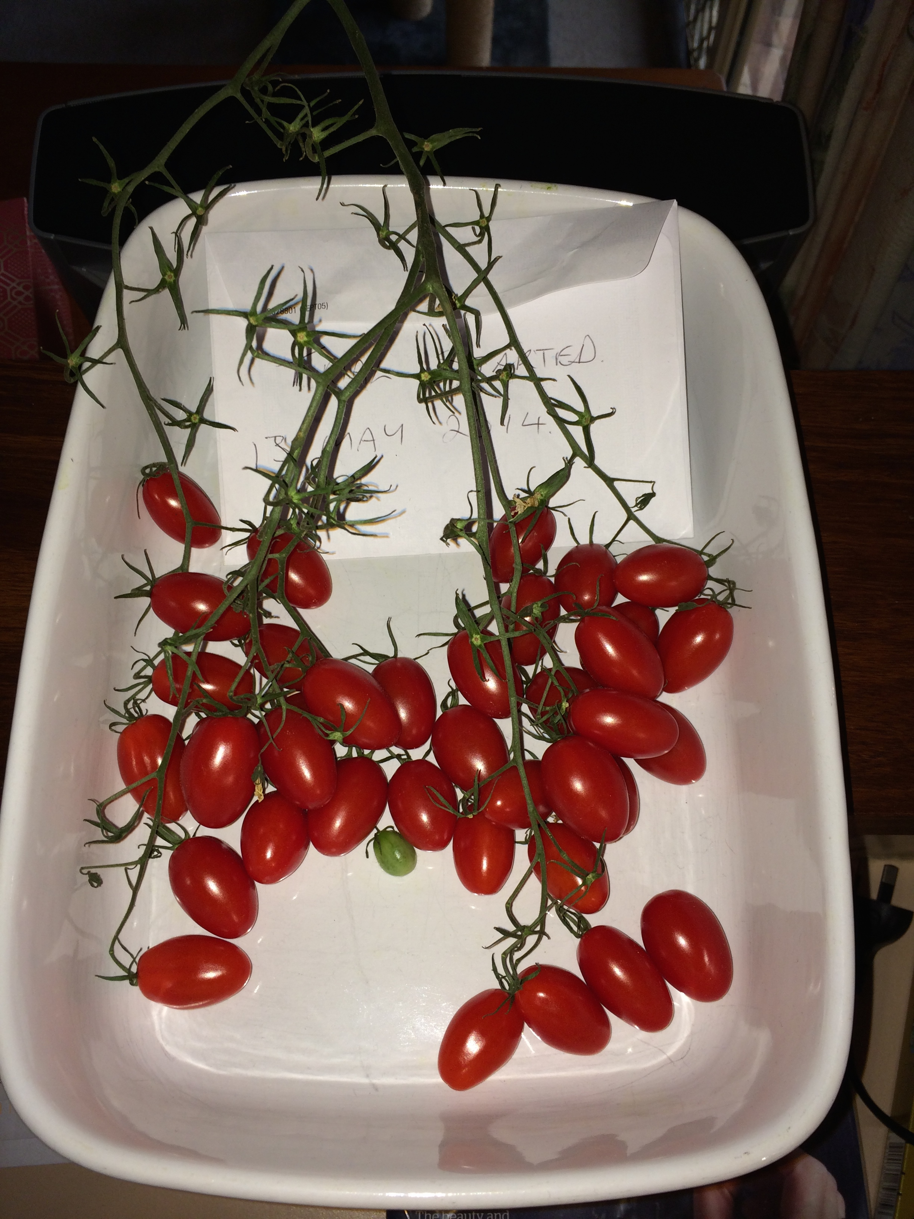
25th May 2014

Slide 5
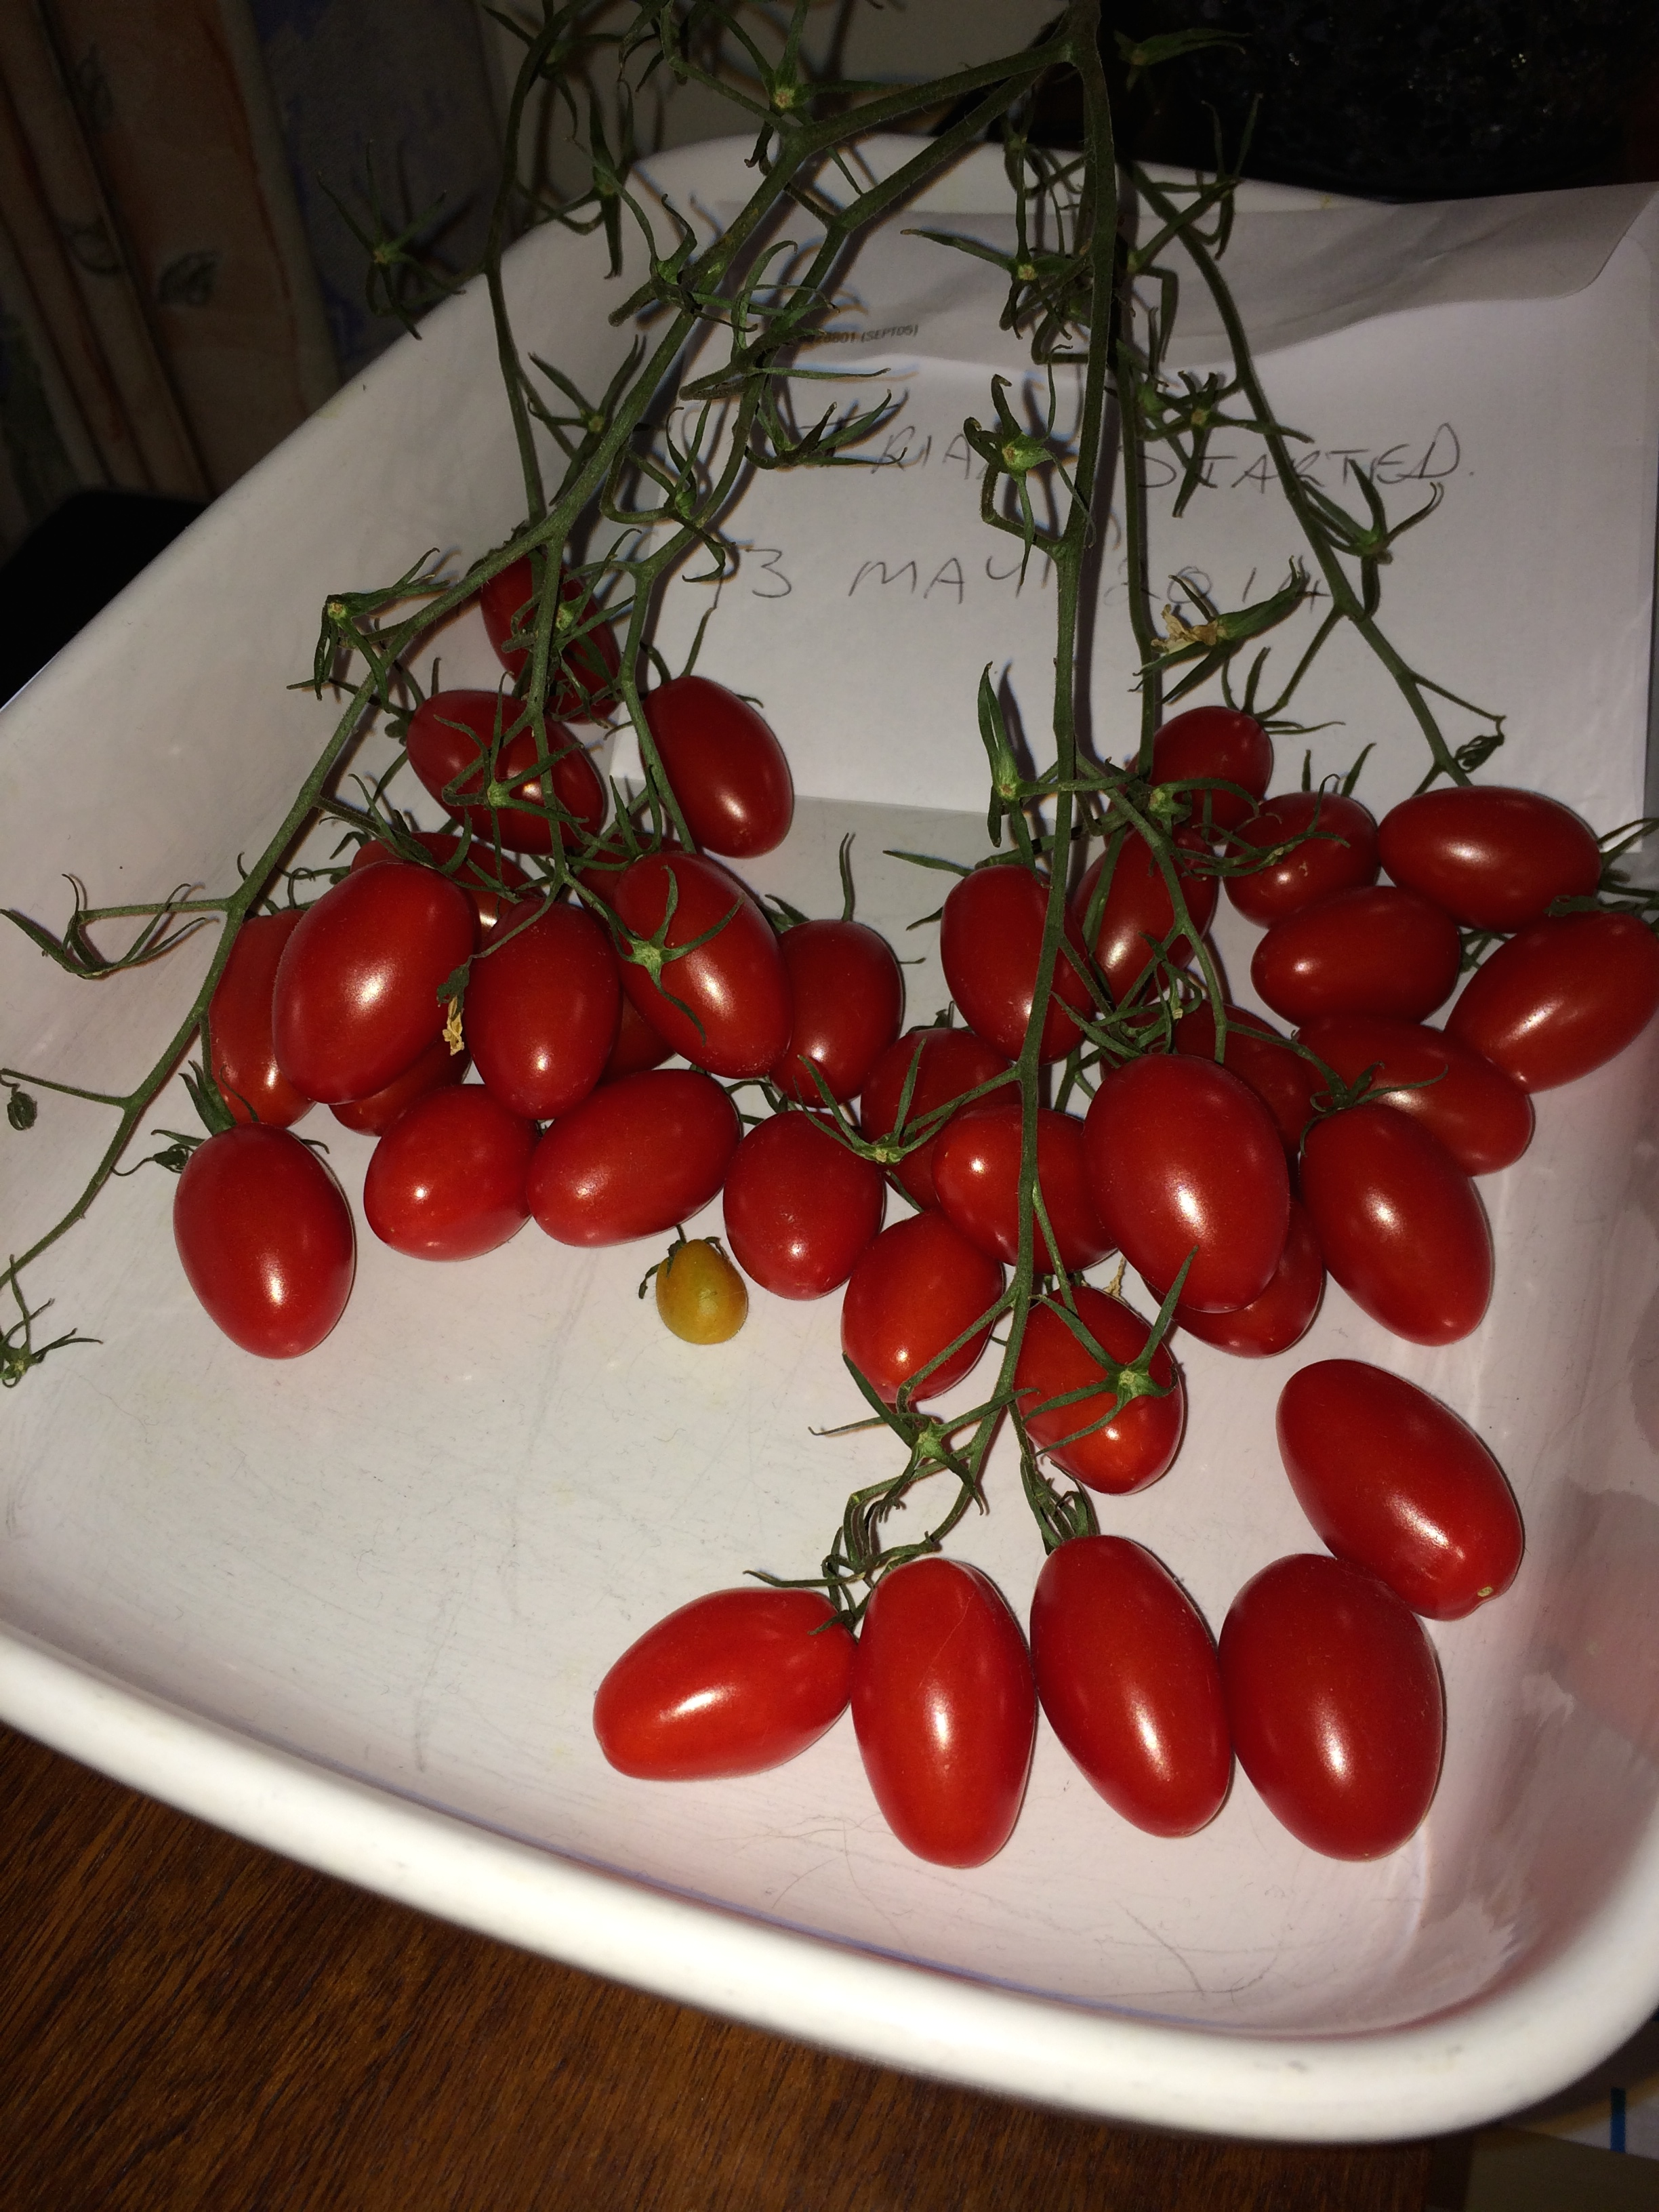
10th June 2014

Slide 6
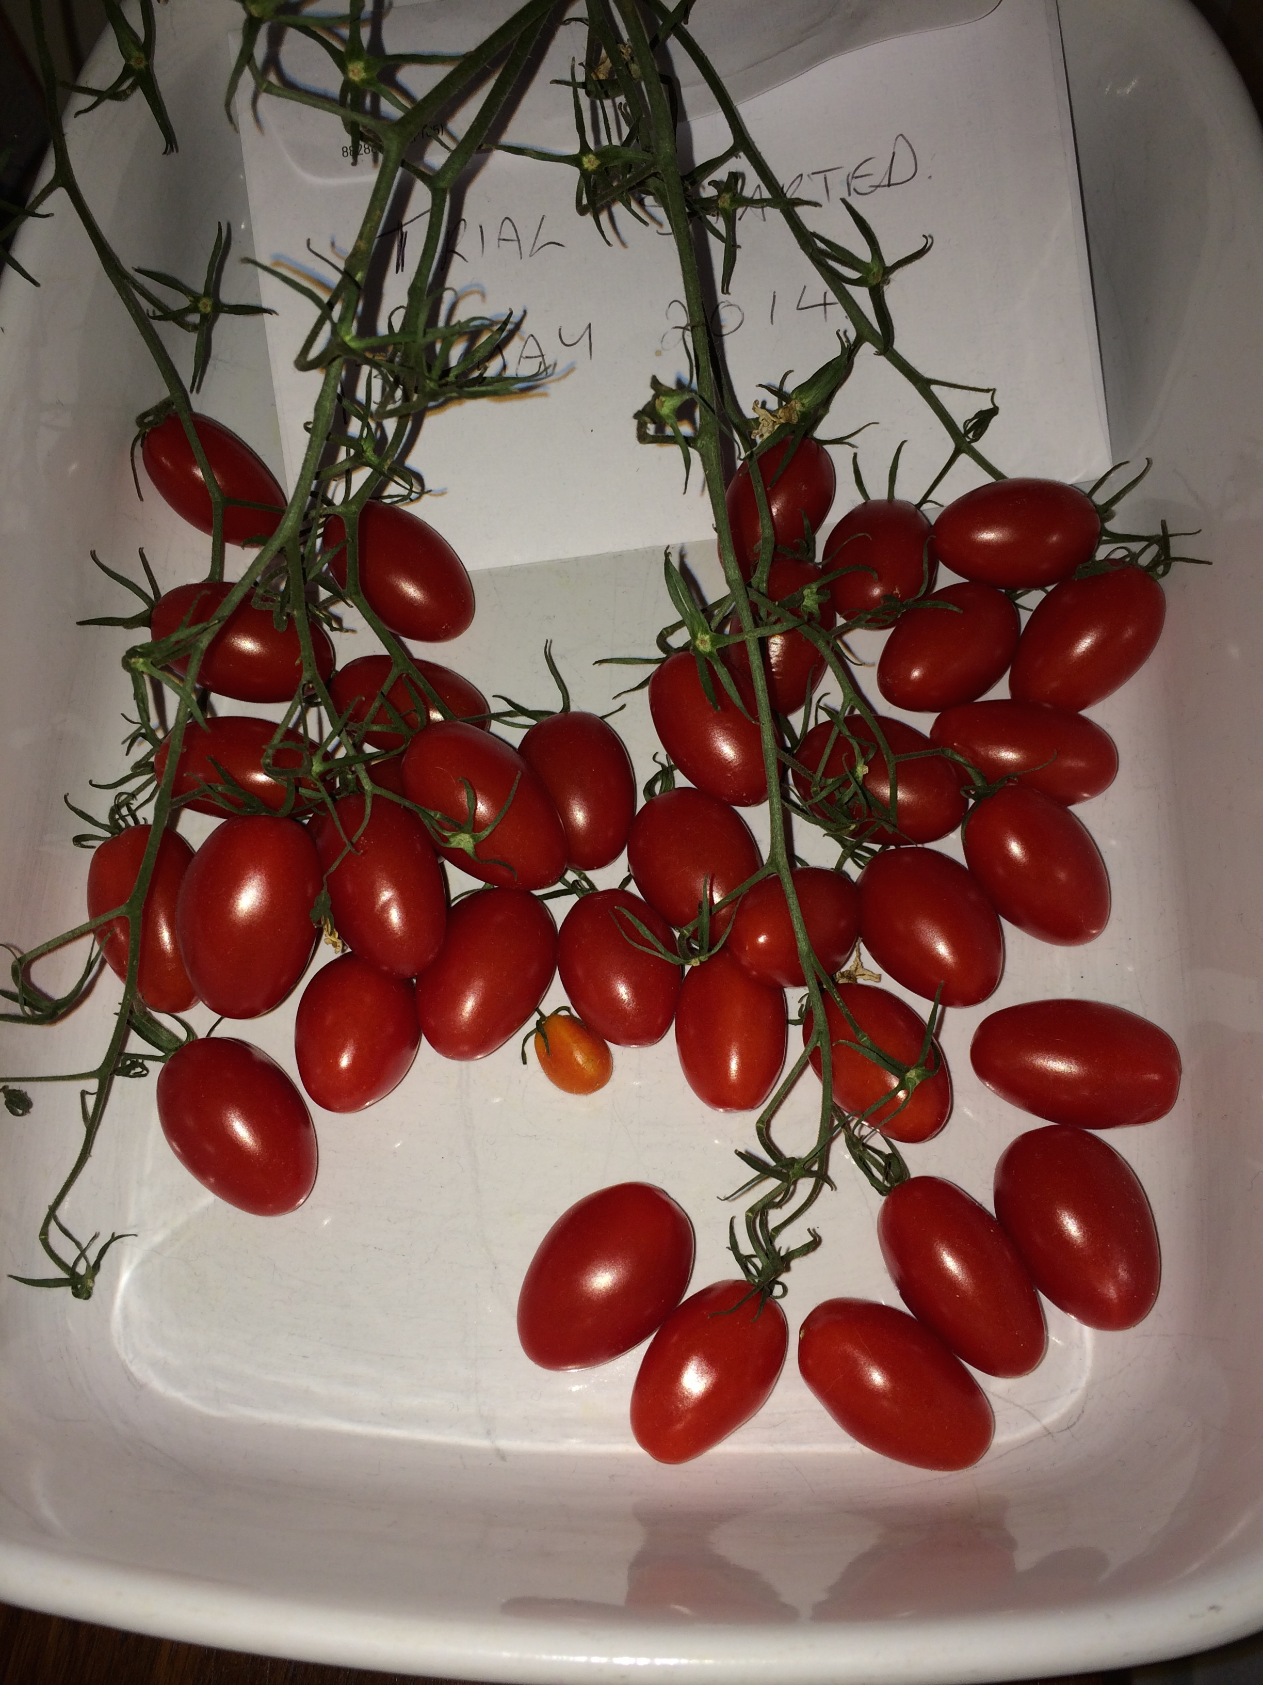
23rd June 2014

